Slide 1
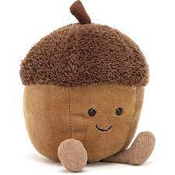
Welcome to Acorns
Knowledge Organiser Spring Term 1

Slide 2
Communication and Language
Listening: Listen carefully to rhymes and songs, paying attention to how they sound.
Attention: Make up our own stories - Introduce Story Scribing/ Helicopter Stories.
Respond: Join in with repeated phrases of traditional tales. Express their ideas and feelings about their experiences using full sentences, including use of past, present and future tenses and making use of conjunctions, with modelling and support from their teacher’s and songs, paying attention to how they sound.
Understanding: Share our favourite stories from home. Talk through main events of stories.
Speaking: Articulate their ideas and thoughts in well-formed sentences. Use and celebrate newly acquired vocabulary.
Participate in small group, class and one-to-one discussions, offering their own ideas. Connect one idea or action to another using a range of connectives.
Vocabulary Concepts:
First, next, beginning, middle, end, after, then, next, character, plot, setting, story, book, where, why, when, what.
Revisit/ ongoing throughout the year:
Learn new vocabulary Use new vocabulary in different contexts
Use new vocabulary through the day in discussions and conversations
Learn new rhymes, poems, songs,traditional stories
Listen to and talk about stories to build
familiarity and understanding
Home Learning:
Retell traditional stories in sequence and using repetitive language found in the text eg Run, run as fast as you can.

Slide 3
Personal, Social & Emotional Development
Express feelings: and social skills
Identify and moderate their own feelings socially and emotionally. Talk about how they are feeling and be able to label these emotions.
Manage behaviour: / Self-awareness:
Compromising and solving conflicts; understanding how actions affect others. Be able to engage in reflective conversations based around conflict or behaviour.
Show resilience and perseverance in the face of challenge.
Vocabulary:
Challenges, perseverance, jobs,
Responsibilities, taking turns, being polite, manners, help, dreams, goals.
Revisit/ ongoing throughout the year:
Continue to develop skills of using gestures, non-verbal communication, facial expressions, body language, appropriate language, and vocabulary
Listen to others, speak to peers and adults and engage in discussions in a positive way
Jigsaw: Dreams & Goals
Discussion about the Christmas holiday.
Challenges
Perseverance
Goal-setting
Overcoming obstacles
Seeking help
Jobs
Achieving goals
Home Learning:
Decide upon and practise a new skill. Take pictures to bring in and share.

Slide 4
Revisit/ ongoing throughout the year
Continue to develop overall body-strength, balance, coordination, and agility through use of outdoor play equipment.
Physical Development
REAL PE FOCUS
Personal Cog Focus: Cognitive skills; to follow and understand simple instructions and name some things i am good at.
Fundamental movement skills:
dynamic balance- maintain balance while walking in a line
static balance- exploring stance with good control
Gross motor:
Ball skills- aiming, dribbling, pushing, patting, or kicking.
Develop confidence, competence, precision, and accuracy when engaging in activities that involve a ball.
Fine motor:
Begin to form letters correctly
Handle tools, objects, construction and malleable materials with increasing control
Home Learning
Use scissors to cut out simple shapes accurately by tracing the line. Use your shapes to make a picture.
Vocabulary
Dribbling, patting, catching, kicking, aiming, target.
Balance, climbing, symmetry.
Construct, tools, snip, cut, join, fold.
Notes:
PE Progression of Skills

Slide 5
Literacy
Vocabulary:
Phoneme, sound, phoneme frame, sound buttons, grapheme, rhyme, print, words, letters, sounds, books, story, blend, segment, word, sentence, finger space, full stop, caption, facts, non-fiction, title, label, explain, actions, re-tell, sequence, props, picture, characters, problem, beginning, middle, end, character description, fiction, story map, once upon a time, then, now, emotions, scared, sneaky, naughty.
Revisit/ ongoing throughout the year
Re-read books to build up their confidence in word reading, their fluency and their understanding and enjoyment. Read books consistent with their phonic knowledge.
Writing:
Extend spoken vocabulary.
Recognise some familiar words. Begin to form letters correctly.
Use writing as a means of communicating to audience
Write own name and labels/captions
Write simple refrain from the story. E.g. Run, run as fast as you can.
Language:
Introduce word of the day, display and celebrate the use of new words.
Introduce Grandma Fantastic and her vocabulary in her basket.
Handwriting: Pegs to Paper & Penpals.
Penpal handwriting books used to practise formation.
Helicopter Stories:
Adults to scribe children’s stories and act them out on a story stage.
:
COMPREHENSION:
Demonstrate understanding of what has been read to them by retelling stories and narratives using their own words and recently introduced vocabulary. Anticipate (where appropriate) key events in stories.
Retell a story with story language and a problem.
WORD READING:
Begin to segment sounds and blend.
Read some letter groups that each represent one sound and say sounds for them.
Read a few common exception words matched to Phonic Bug.
Home Learning:
Fold paper to make your own book including characters from familiar stories. Can you read the story to your family at bedtime?

Slide 6
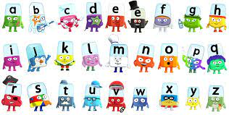
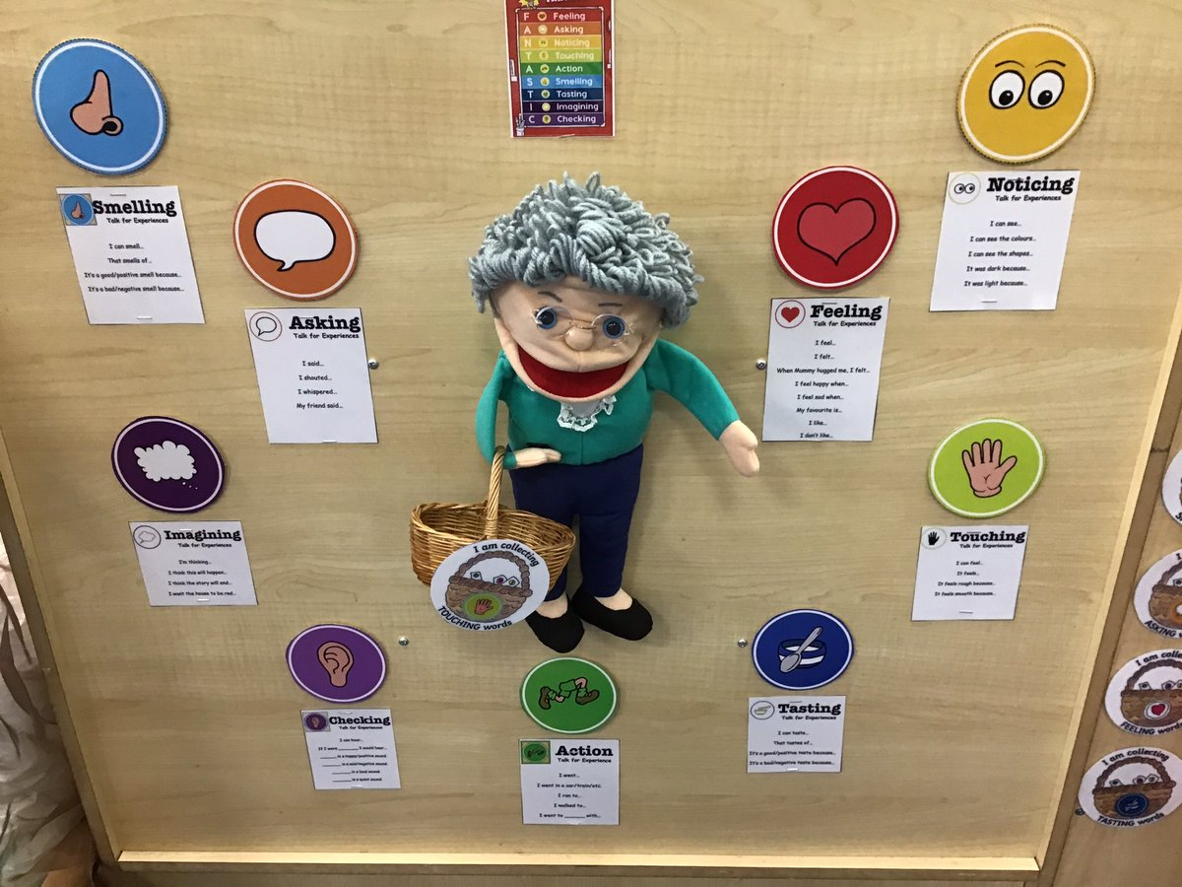
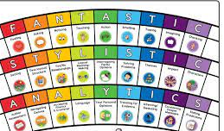
Revisit/ ongoing throughout the year
Continue to develop general sound discrimination, rhythm and rhyme, alliteration, voice sounds, oral blending, and segmenting.
The Write Stuff
Understanding of the uniqueness of each child
Nurturing deep talk and developing listening
Providing a rich repertoire of real and imagined experiences to ignite writing
Grandma Fantastic EYFS Rainbow
Phonics
Phase 3 phonics - learning digraph
phononems and word building with these sounds:
Sh, ch, th, ai, ee, oa, oo, oo, igh.
Home Learning
Can you carry out a sound walk using your phonic cards? What can you find contain the digraph sounds we have learnt this term?

Slide 7
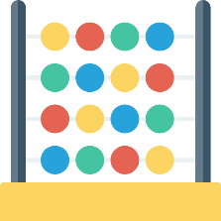
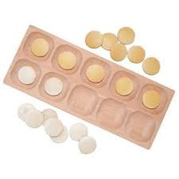
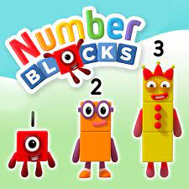
Mathematics
Vocabulary:
Four, five, six, seven, build, count, one more, oneness, recognise
Predict, add, take away, equals, sides, shapes, square.
Rectangle, corners, number line, order, smallest, biggest, difference, count back, count forwards, number bonds.
Number and Patterns: Composition of 4, 5, 6, 7
Adding and subtracting to 4 and 5
Digging Deeper / Problem solving: Children solving problems relating to addition and subtraction to 5.
Early doubling.
Count reliably any arrangement of up to 7 objects
Find one more and one less than a number from 1 to 10
Begin to estimate how many objects can be seen and check by counting (up to ten)
Shape Space and Measures:
Recognise patterns
Use everyday language related to capacity
Days of the week
Home Learning:
Can you use a mirror to double a group of objects?

Slide 8
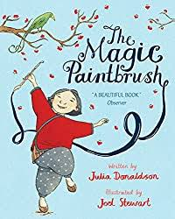
Revisit/ ongoing throughout the year
Communication: Understand the past through settings, characters and events encountered in books read in class and storytelling
Observation: Winter Trees
Understanding the World
Vocabulary:
Chinese New Year, Chinese dragon, Chinese numbers, Chinese lantern, past, present, future, change, winter, season, environment, ice, cold, frozen, wind, sun, sky, moon, light, dark, heat.
RE: What can we learn from stories? Looking at a range of stories with strong morals from different religions.
Science
Recognise some environments that are different to the one in which they live.
Lunar New Year & Chinese New Year - how is this celebrated around the world and how do people prepare for the celebration?
Snap Science- What happens at night? What is in the sky? What is the moon?
Forest School: Tools – saw & loppers
Discovery RE: What can we learn from stories?
Home Learning:
Research how Chinese New Year is celebrated around the world.

Slide 9
Expressive Arts and Design
Colour mixing – secondary colours
Rockets – 3D collages
Construction
Dancing/mime to music
Artist study – -Mondrian (primary colours)
Performance - Chinese New Year songs
Design - design,make and evaluate Chinese New Year decorations
Vocabulary
Primary colours, secondary colours,
Joining, rolling, folding, stencils, decorating, dabbing, sponging, moving, split pins, structure, purpose
Perform, sing, dance.
Revisit/ ongoing throughout the year
Explore, use, and refine a variety of artistic effects to express their ideas and feelings.
Return to and build on their previous learning, refining ideas and developing their ability to represent them
Explore and engage in music making and dance, performing solo or in groups.
Charanga: Everyone Unit:
Wind The Bobbin Up
Rock-a-bye Baby Five Little Monkeys Jumping On The
Bed
Twinkle Twinkle
If You're Happy And You Know It
Head, Shoulders, Knees And Toes
Musical Activities that embed pulse, rhythm and pitch, explore voices and classroom instruments.
Copy-clap some rhythms of phrases from the songs.
Explore high pitch and low pitch in the context of the
songs.

