Slide 1
Little Wandle at St John’s
Parent workshop: Phonics and early reading

Slide 2
Welcome
Notes:
Introduce staff

Slide 3
Aims
To understand what phonics is and some of the terminology that your child may bring home
To understand how phonics builds and leads to fluency in reading and confidence in writing
To understand how reading will be taught in school
To understand the expectations of reading at home
To understand how you can support your child
To know where to go for help and support, as a parent whose child is learning to use phonics

Slide 4
Phonics

Slide 5
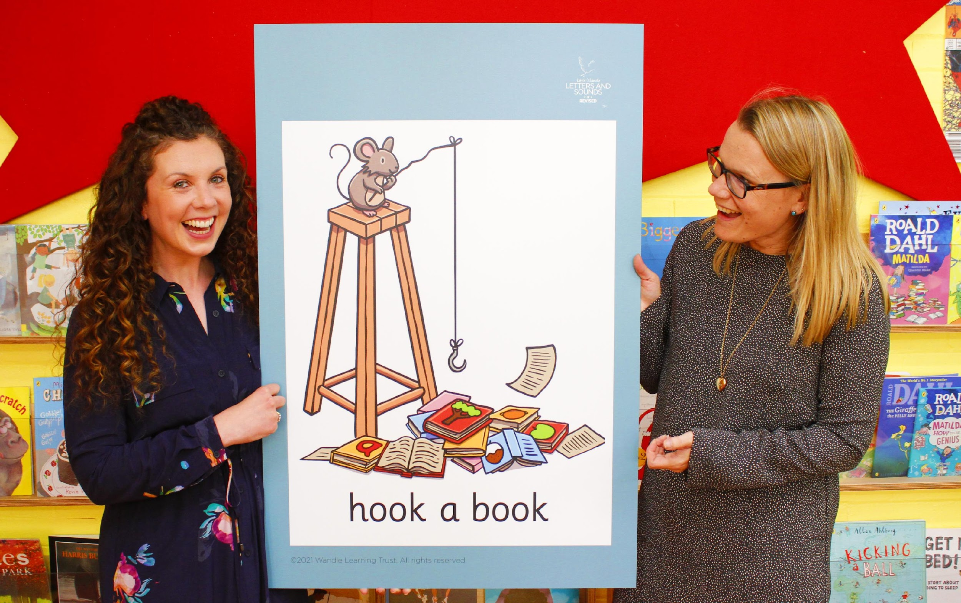
Little Wandle Letters and Sounds Revised
Little Wandle Letters and Sounds Revised is our systematic, synthetic phonics (SSP) programme to teach early reading and spelling. This means that it is structured and fully comprehensive.
Notes:
Share our new phonics scheme, explain why we have moved (Gov changes, previous document was scrapped for all schools. We have chosen LW as it is a very comprehensive package).

Slide 6
Phonics is:
making connections between the sounds of our spoken words and the letters that are used to write them down.

Slide 7
Terminology
Phoneme- The smallest unit of sound made by a letter/group of lettters
Split vowel digraph- When a vowel sound is split by a consonant. eg. cake
Grapheme- The written letter/letters
Blend- Joining together of sounds to build a word
Digraph- Two letters which make one sound
Segment- Splitting words up into sounds
Trigraph- Three letters which make one sound
Notes:
Explain what each word means

Slide 8
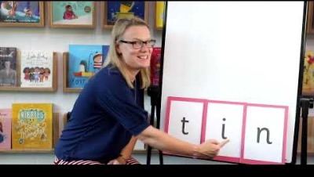
Blending to read words
Notes:
Some children learn to blend really quickly, and others take a little longer.
Show parents this video from the website: https://www.littlewandlelettersandsounds.org.uk/resources/for-parents/

Slide 9
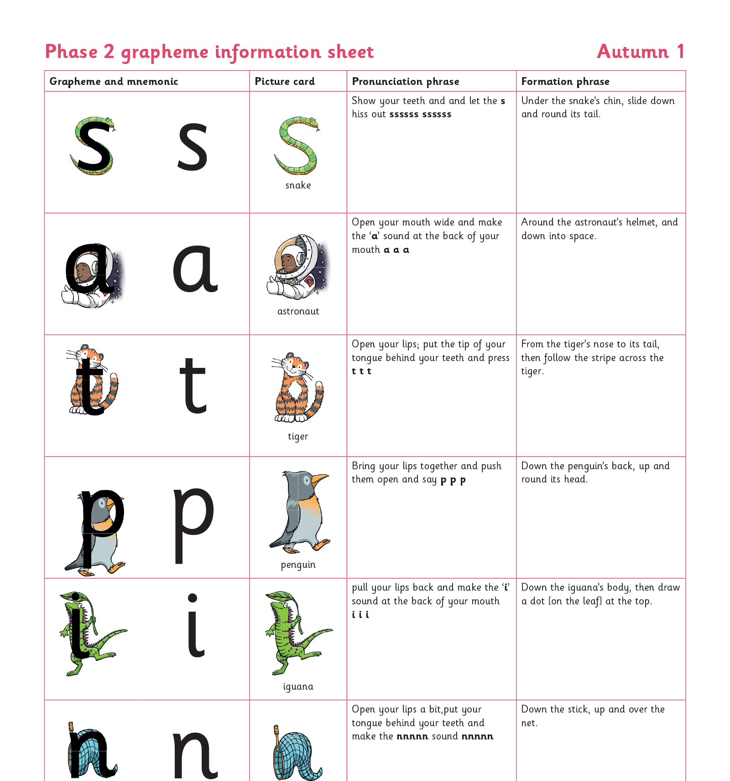
Teaching order
Notes:
You will get a copy of the sounds that we are learning to use at home. This will help you with formation and pronunciation.

Slide 10
Reading and spelling in school

Slide 11
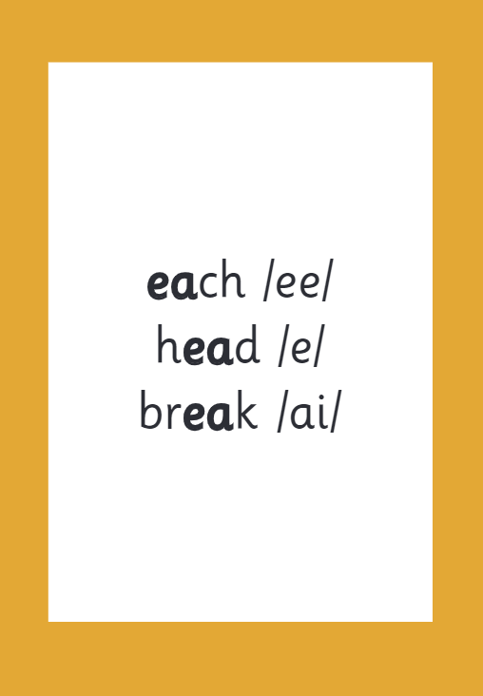
Reading and spelling
Notes:
This is an example of what the children learn in Year 1.
Children learn that there are graphemes that can have different sounds and sounds that can be made with different letters.

Slide 12
And all the different ways to write the phoneme sh:
shell
chef
special
caption
mansion
passion
Notes:
A second example of Yr 1

Slide 13
Spelling
Say the word.
Segment the sounds.
Count the sounds.
Write them down.
Notes:
How children are taught to spell through phonics.
Once a child’s phonic journey is complete, they will move on to our Spelling Scheme this happens at around year 2.

Slide 14
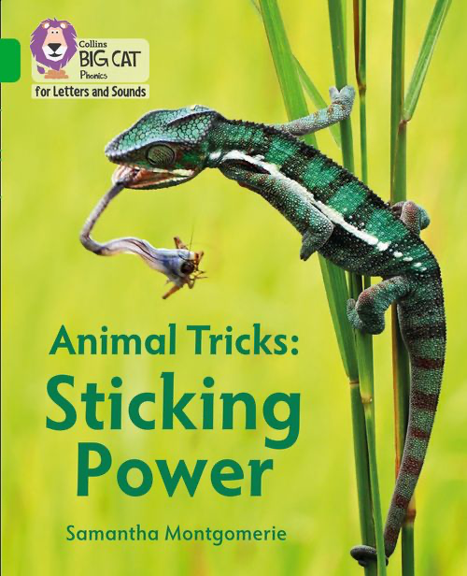
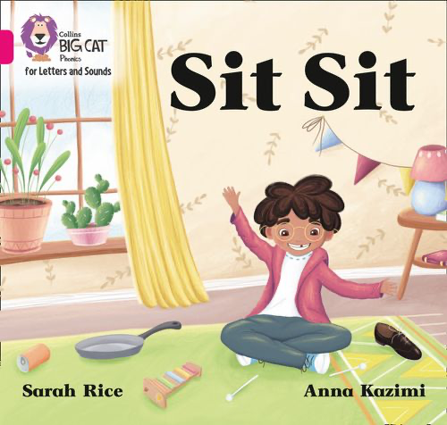
How do we teach reading in books?
Reading practice sessions are:
timetabled twice a week
taught by a trained teacher/teaching assistant
taught in small groups.
Notes:
Children will read the same book twice in a week at school.

Slide 15
We use assessment to match your child the right level of book
Notes:
We assess your child regularly to check progress.

Slide 16
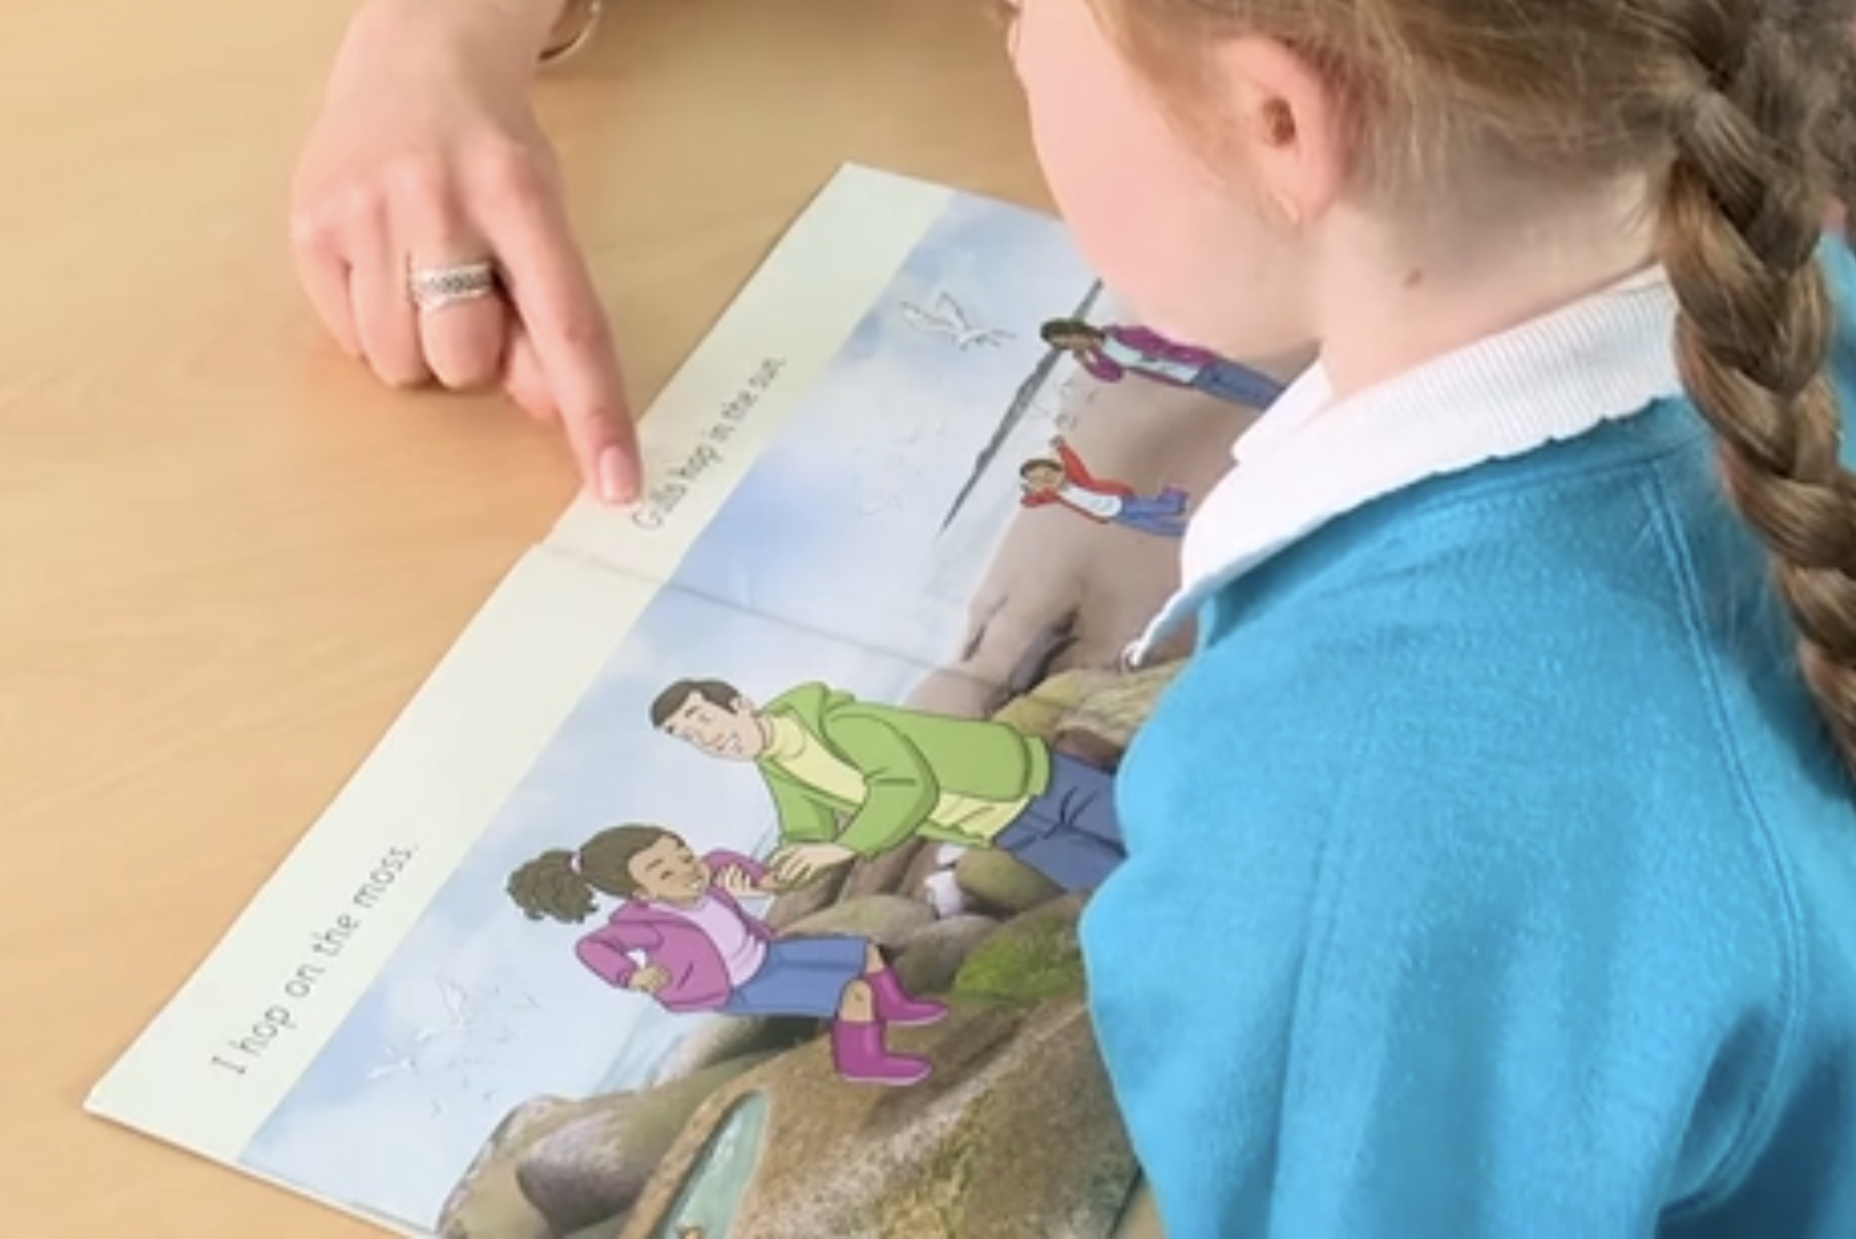
Reading a book at the right level
This means that your child should:
Know all the sounds and tricky words in their phonics book well
Read many of the words by silent blending (in their head) – their reading will be automatic
Only need to stop and sound out about 5% of the words by the time they bring the book home – but they should be able to do this on their own.

Slide 17
Reading at home

Slide 18
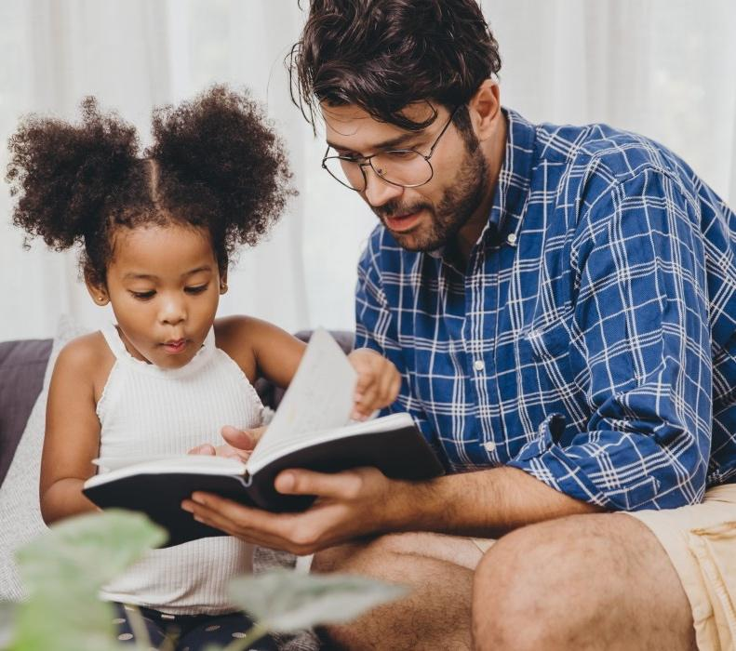
The most important thing you can do is read with your child
Reading a book and discussing it had a positive impact a year later on children’s ability to…
understand words and sentences
use a wide range of vocabulary
develop listening comprehension skills.
The amount of books children were exposed to by age 6 was a positive predictor of their reading ability two years later.
Parental involvement in the development of children’s reading skills: A five-year longitudinal study (2002) Senechal, M. and Lefvre, J
Notes:
Celebrate child’s success at school, make time for reading at home!

Slide 19
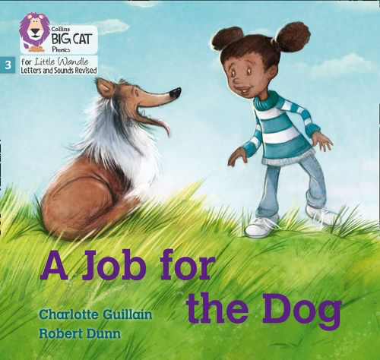
Books going home and e-readers
Notes:
E-readers have been purchased in order to ensure that children have access to the texts that they have been reading in class. Allocations will be made clear in reading records.

Slide 20
Read to your child
The shared book is for YOU to read:
Make the story sound as exciting as you can by changing your voice.
Talk with your child as much as you can:
Introduce new and exciting language
Encourage your child to use new vocabulary
Make up sentences together
Find different words to use
Describe things you see.

Slide 21
Listening to your child read their phonics book
Your child should be able to read their book without your help.
If they can’t read a word read it to them.
Talk about the book and celebrate their success.

Slide 22
Supporting your child with phonics
Notes:
It is really important that you pronounce the sounds correctly at home if you are supporting your child. These videos are on the website for you to refer to and if you are unsure, please ask your child’s teacher. https://www.littlewandlelettersandsounds.org.uk/resources/for-parents/

Slide 23
Support for parents and families
Your child’s teacher or TA.
Little Wandle Website www.littlewandlelettersandsounds.org.uk

