Slide 2
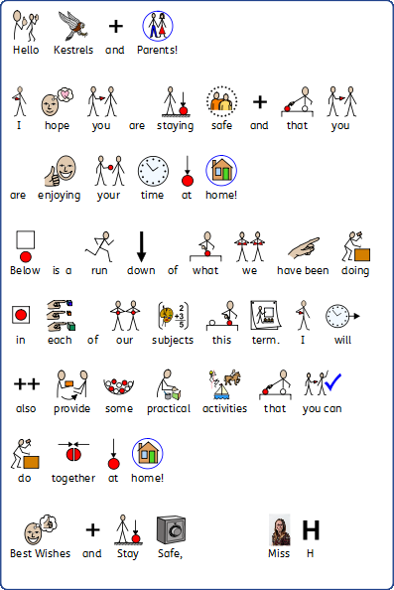

Slide 4
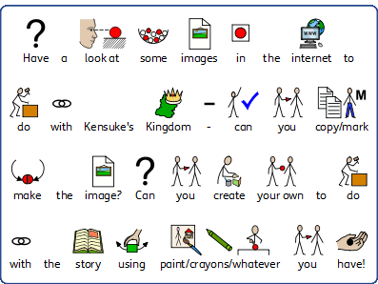

Slide 5
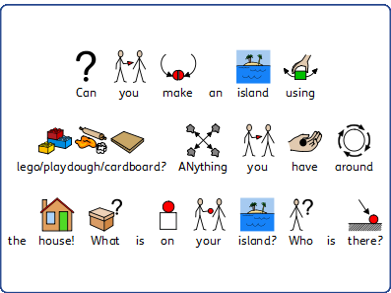
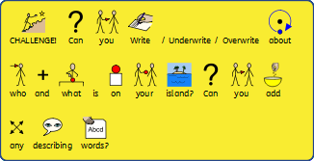

Slide 6
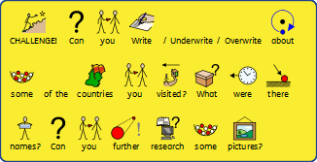
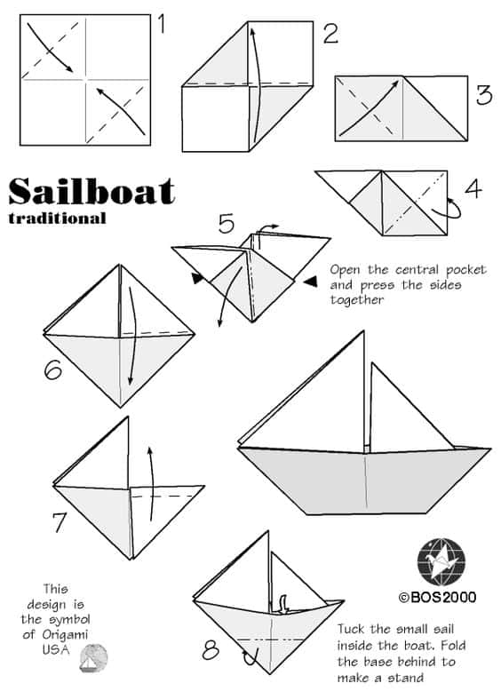

Slide 7
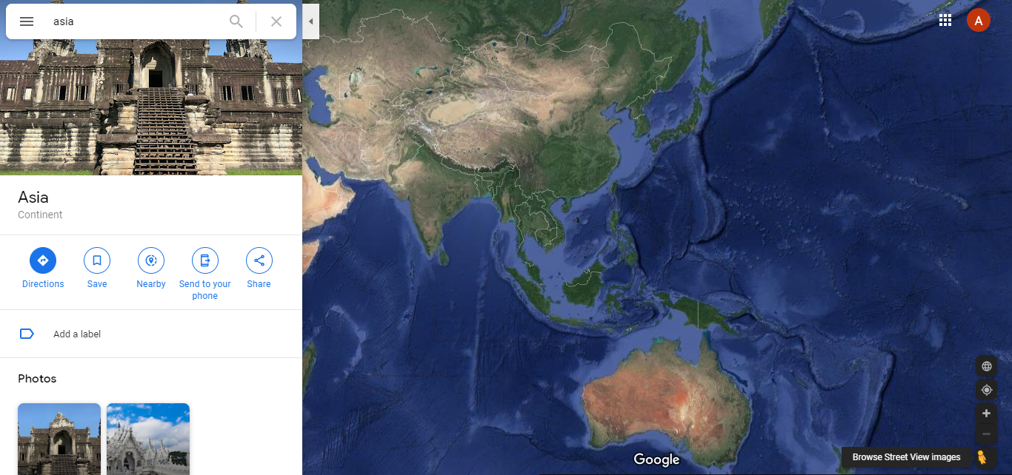
Pick up the little man
and place him anywhere
that goes blue!

Slide 9
Online Links to further activities:
- Phonics Play phases 2 – 5
https://www.phonicsplay.co.uk/BuriedTreasure2.html
- Top marks themed island resources and activities to explore
https://www.topmarks.co.uk/Search.aspx?q=island
Youtube Kensuke’s kingdom videos
https://www.youtube.com/watch?v=pAqlVRiCVvw (summary of the whole story)
https://www.youtube.com/watch?v=N8y-5JcoKKc&t=31s (Book trailer)
https://www.youtube.com/watch?v=XDY81-fQaS4 (Introduction from the Author)

Slide 17
Online Links to further activities:
Twinkl has lots of word problem and general resources and is offering a free parent membership at the moment (don’t feel like you have to use it, its just available if you’d like to use it)
https://www.twinkl.co.uk/search
Generally TopMarks is very good for any maths activities so explore any games on there, the following are just some ones related to our topic:
Number recognition https://www.topmarks.co.uk/learning-to-count/teddy-numbers
Counting along numbers to 20 http://resources.hwb.wales.gov.uk/VTC/ngfl/ngfl-flash/numbers_eng/numbers_e.html
The Four operations train game https://www.topmarks.co.uk/maths-games/mental-maths-train
Harder multiples game https://www.topmarks.co.uk/times-tables/coconut-multiples
Harder fast questions game https://www.topmarks.co.uk/maths-games/hit-the-button
Toy shop money recognition https://www.topmarks.co.uk/money/toy-shop-money
Making Change https://natwest.mymoneysense.com/students/students-5-8/the-change-game/
Maths Playground (just a different online maths resource site) https://www.mathplayground.com/math-games.html
Number songs we use in class (sensory learners particularly):
https://www.youtube.com/watch?v=0TgLtF3PMOc (ALL CHILDREN)
https://www.youtube.com/watch?v=1dkPouLWCyc (ALL CHILDREN)
https://www.youtube.com/watch?v=yTeUqWGCKjA (ALL CHILDREN)
https://www.youtube.com/watch?v=7D4K9oi7oBM&t=1029s (Sensory learners)
https://www.youtube.com/watch?v=_jxzZMw89qY (sensory learners)
https://www.youtube.com/watch?v=D0Ajq682yrA (sensory learners)
https://www.youtube.com/watch?v=DR-cfDsHCGA (sensory learners)

Slide 19
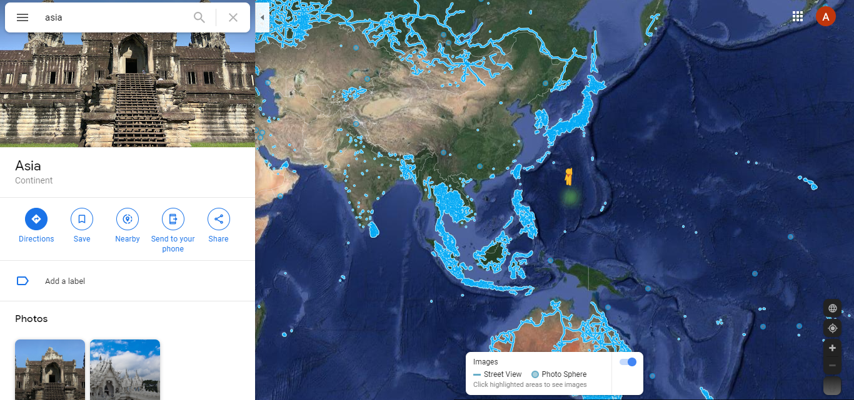
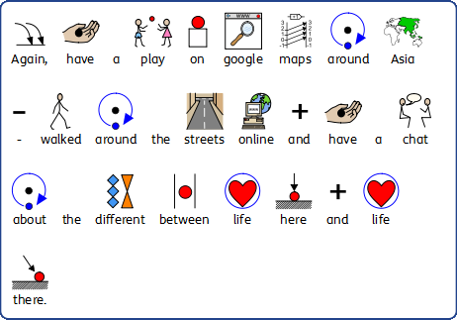

Slide 21
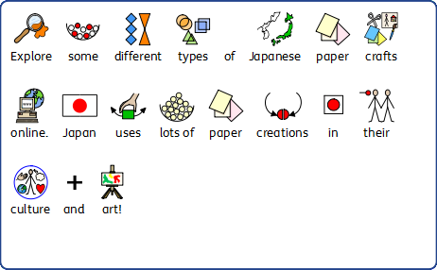

Slide 22
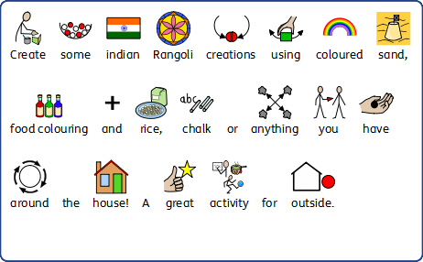

Slide 23
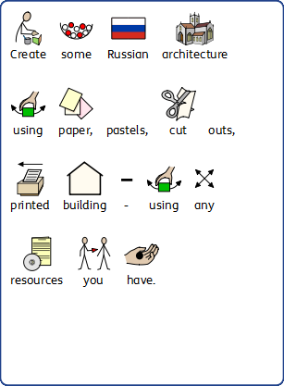

Slide 25
Online Links to further activities:
Twinkl has lots of English and general theme resources and is offering a free parent membership at the moment (don’t feel like you have to use it, its just available if you’d like to use it)
https://www.twinkl.co.uk
Asian Geography quiz and game site http://sheppardsoftware.com/Asian_Geography.htm
National Geographic kids has LOADS of resources and games for kids https://www.natgeokids.com/uk/category/play-and-win/games/
Topmarks again has lots more online resources you can use https://www.topmarks.co.uk/Search.aspx?Subject=12
Youtube is always good for watching videos about landscapes and for accompanying music for craft activities. Also for sensory learners – if your trying inclusive craft or mark making, it’s a lovely engagement tool.

Slide 26
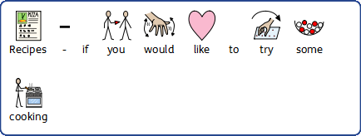
All recipes can be adapted and I’ve
tried to find quick and easy ones

